Slide 1
CS3102 Theory of Computation
www.cs.virginia.edu/~njb2b/cstheory/s2020
Warm up:
How does a Human “compute”?
What are the resources available to a human to do computing?

Slide 2
Learning/memorizing subroutines
Brain (is like a cpu)
Brain also has short term memory
Senses (input), speech, writing (output)
Use writing/utensils to remember things
Pondering (using a “working memory”)

Slide 3
Most important parts (according to Nate)
CPU
Circuits of transistors
Brain
RAM
Limited memory
Working memory
HDD/SSD
Large memory
“plentiful” memory, infinite memory
Documents, notes, etc.

Slide 4
Issues and Solutions
What were the limitations of circuits?
Actually infinite inputs (not relevant to us)
No looking back!
Change the machine mid-process
Limited storage, bigger inputs require more memory for some functions
Larger output space (only 0 or 1)
Non-determinism: no communication among parallel paths
Outside the scope of this semester
Alternation
How can we overcome those?
You can look backwards!
Lots of / Plentiful / enough memory: infinite!
Make machines that can play the roll of another machine, compute machines (macros)
Execution model that allows for long strings to be outputs

Slide 5
Characterizing What’s computable
Things that are computable by FSA (NFA/DFA):
Functions that don’t need “unbounded memory”
Languages expressible as Regular Expressions
Things that aren’t computable by FSA:
Things that require more than finitely many states
Intuitive example: Majority

Slide 6
Majority with FSA?
Consider an inputs with lots of 0s
Recall: we read 1 bit at a time, no going back!
To count to 50,000, we'll need 50,000 states!
000...0000 111...1111
000...0000 111...1111
000...0000 111...1111
×50,000
×50,000
×50,000
×50,001
×49,999
×50,000

Slide 7
Machine Configurations
Configuration: All the information needed to represent the “status” of an execution
Circuit: the circuit itself, all variables and their values
Automaton: the implementation of the automaton, currently active state(s)
Java program: the values of all the variables, the contents of all the data structures, call stack.
Solution: have a model with an unbounded number of potential configurations

Slide 8
Turing Machines
FSA:
Finite number of states,
read-once input,
transition using input bit and state(s)
Turing Machine:
Finite number of states,
Read-once input,
Semi-infinite tape (memory)
Transition using “current symbol” on tape
Can overwrite current symbol, move left/right on tape

Slide 9






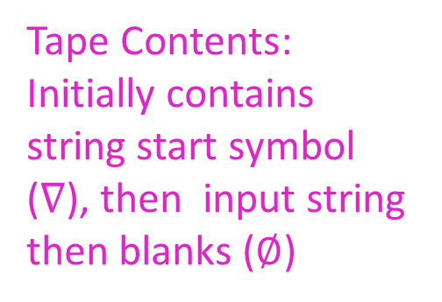




Turing Machine
States, transitions, etc.
FSA
Tape Contents: Initially contains string start symbol ($∇$), then input string then blanks ($∅$)
$$∇$$
$$X$$
$$0$$
$$0$$
$$X$$
$$1$$
$$1$$
$$∅$$
$$∅$$
$$∅$$
…
Semi-infinite tape (memory)
Operation:
transitions outgoing from each state match on current character on the tape, when transitioning you can overwrite that character and move which cell you’re reading
Return 1 if we enter the accept state, Return 0 if we enter the reject state

Slide 10
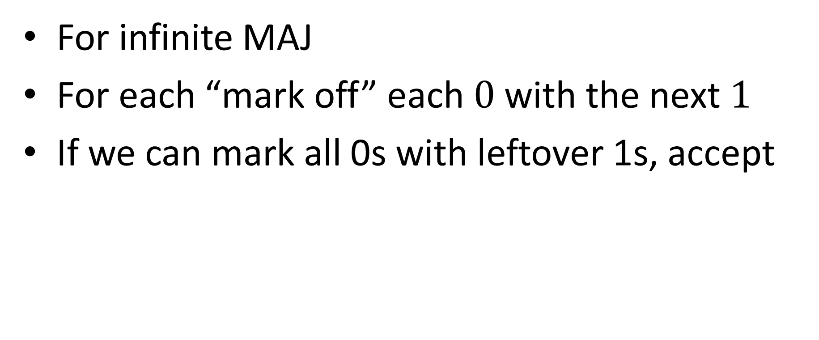
Example Turing Machine
For infinite MAJ
For each “mark off” each $0$ with the next $1$
If we can mark all 0s with leftover 1s, accept

Slide 11















Input: $01101$
Start from beginning, move right while looking for a 0,
If you find a 0, mark it, go to the beginning,
Move right while looking for a 1
If you find a 1, mark it, go to the beginning
Repeat 1-4 until no more 0s or no more 1s
Go back to beginning, return 1 if we can find more 1s
Else return 0
Return 1
$$∇$$
$$×$$
$$1$$
$$1$$
$$0$$
$$1$$
$$∅$$
$$∅$$
$$∅$$
$$∅$$
$$0$$
$$×$$
$$×$$
$$×$$
input

Slide 12
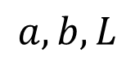


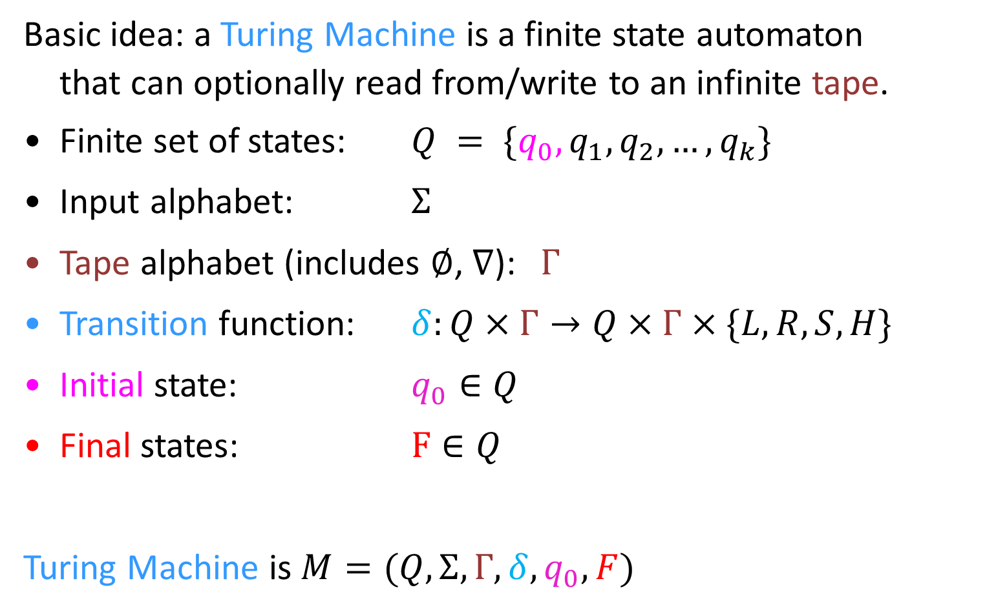
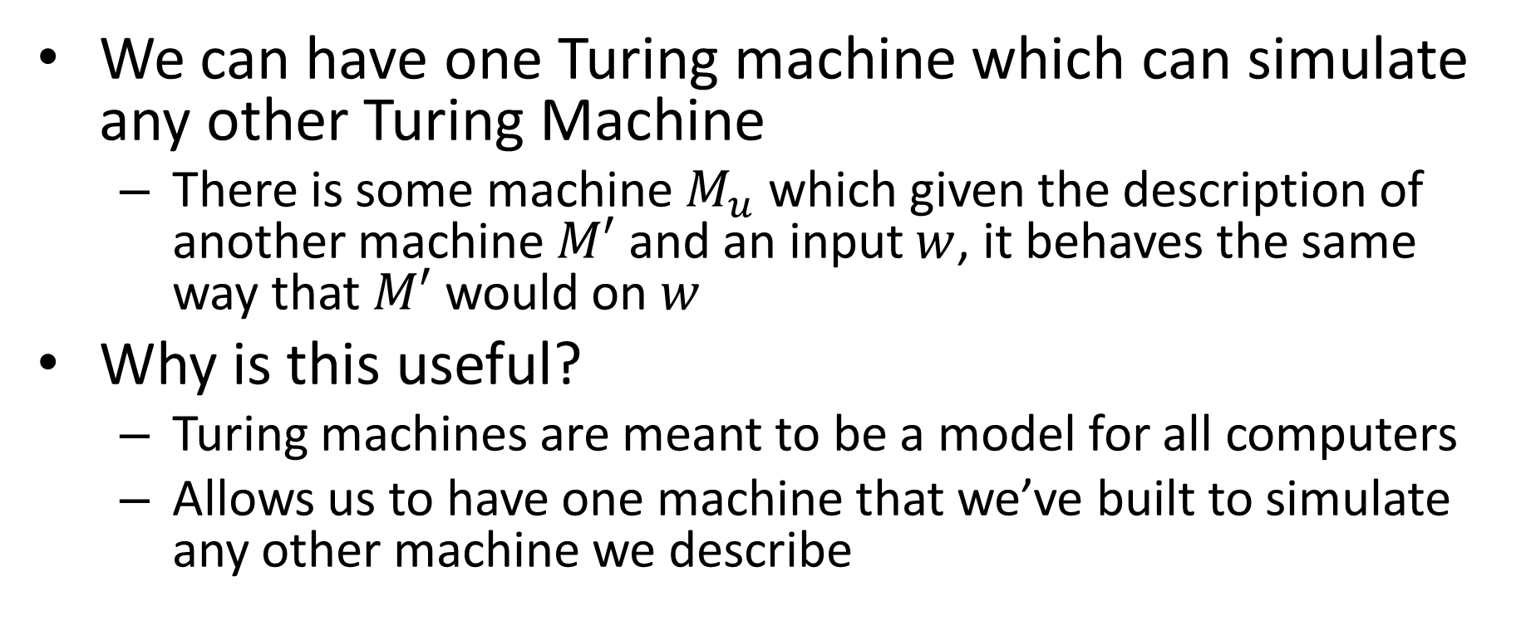
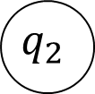
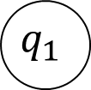
Turing Machine
Basic idea: a Turing Machine is a finite state automaton
that can optionally read from/write to an infinite tape.
Finite set of states: $Q = \{q_{0}, q_{1},q_{2}, …, q_{k}\}$
Input alphabet: $Σ$
Tape alphabet (includes $∅$, $∇$): $Γ$
Transition function: $δ:Q×Γ→Q×Γ×\{L,R,S,H\}$
Initial state: $q_{0}∈Q$
Final states: $F∈Q$
Turing Machine is $M=(Q,Σ,Γ,δ,q_{0},F)$
$$q_{1}$$
Read
Move
$$a, b, L$$
Write
$$q_{1}$$
$$q_{2}$$
$$q_{0}$$
read, write, move
$$A$$

Slide 13
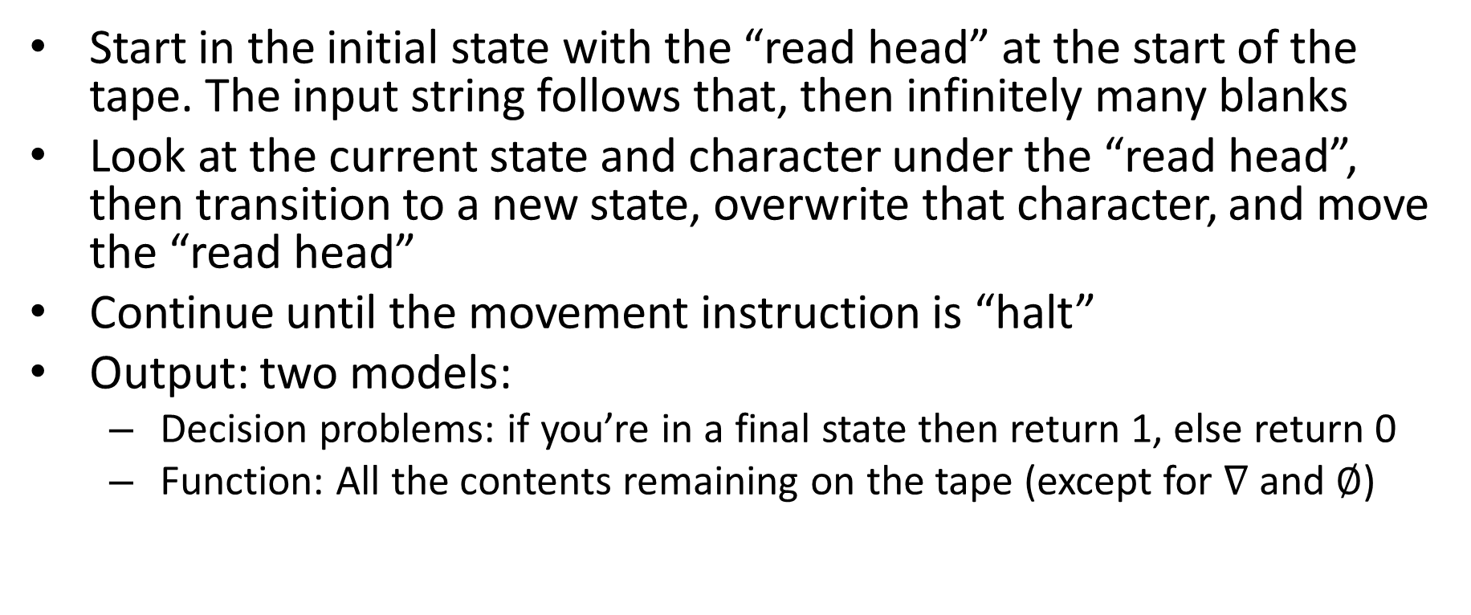
Turing Machine Execution
Start in the initial state with the “read head” at the start of the tape. The input string follows that, then infinitely many blanks
Look at the current state and character under the “read head”, then transition to a new state, overwrite that character, and move the “read head”
Continue until the movement instruction is “halt”
Output: two models:
Decision problems: if you’re in a final state then return 1, else return 0
Function: All the contents remaining on the tape (except for $∇$ and $∅$)

Slide 14
Let’s Draw One!
Start from beginning, move right while looking for a 0,
If you find a 0, mark it, go to the beginning,
Move right while looking for a 1
If you find a 1, mark it, go to the beginning
Repeat 1-4 until no more 0s or no more 1s
Go back to beginning, return 1 if we can find more 1s
Else return 0

Slide 15
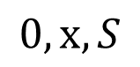
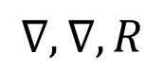
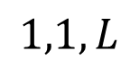
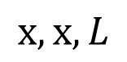
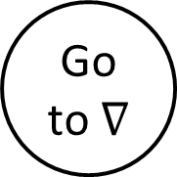
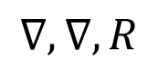
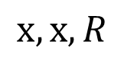
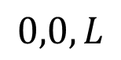
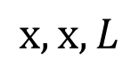
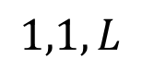
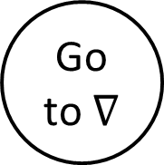
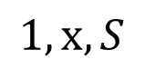
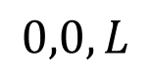
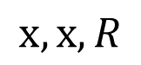
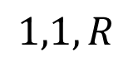
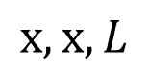
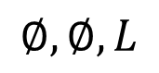
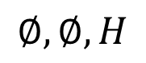
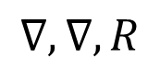
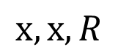
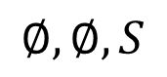
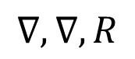
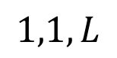
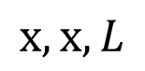
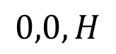
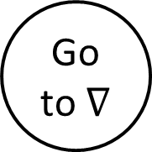
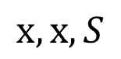
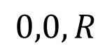
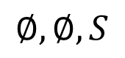
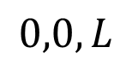
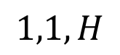
$$1,1,L$$
Turing Machine for Majority
$$1,1,R$$
$$x,x,L$$
$$x,x,R$$
$$0,0,L$$
start
Find 0
Found 0
Go to $∇$
$$∇,∇,R$$
$$0,x,S$$
$$x,x,S$$
$$∇,∇,R$$
$$∇,∇,R$$
$$∅,∅,S$$
$$1,1,L$$
$$x,x,L$$
Go to $∇$
$$x,x,L$$
Found 1
$$1,x,S$$
Find 1
$$0,0,L$$
$$0,0,R$$
$$x,x,R$$
$$∅,∅,S$$
Return 0
$$0,0,H$$
No 0s/1s
Go to $∇$
Find 1
$$∅,∅,H$$
$$∅,∅,L$$
$$∇,∇,R$$
Return 1
$$1,1,L$$
$$1,1,H$$
$$x,x,R$$
$$x,x,L$$
$$0,0,L$$

Slide 16
FSA vs TM
Returns 1 when
FSA: you read the last input character and end up in a final state
TM: you take a halt transition to a final state
Returns 0 when
FSA: you read the last input character and end up in a non-final state
TM: you take a halt transition to a non-final state
FSA: you’ll always eventually read the last character, so they always return something
TM: You can build a machine that, for some inputs, never takes a halt transition!

Slide 17
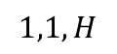
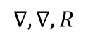
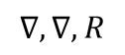
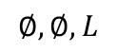
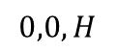
Some Turing Machines never return
while(true){
twiddle(thumbs);
}
In this case they run forever
3 behaviors
Return 1
Return 0
Run forever
This is necessary for computation
while(x != 1){
if(x%2 == 0){
x = x / 2;
}
else{
x = 3x+1;
}
}
$$1,1,H$$
$$∇,∇,R$$
$$0,0,H$$
$$∅,∅,L$$
$$∇,∇,R$$

Slide 18
Running forever
Is it a bad thing?

Slide 19

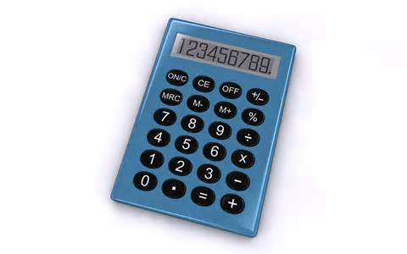
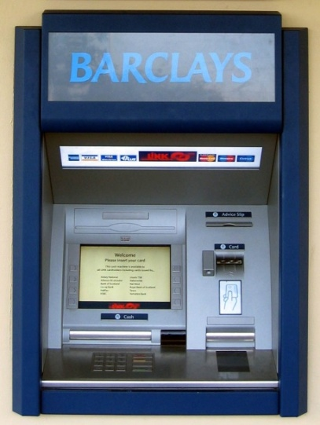




Programs we want to halt:
Programs we want to run forever:
Your 2150 Homework

Slide 20
Church Turing Thesis

Slide 21
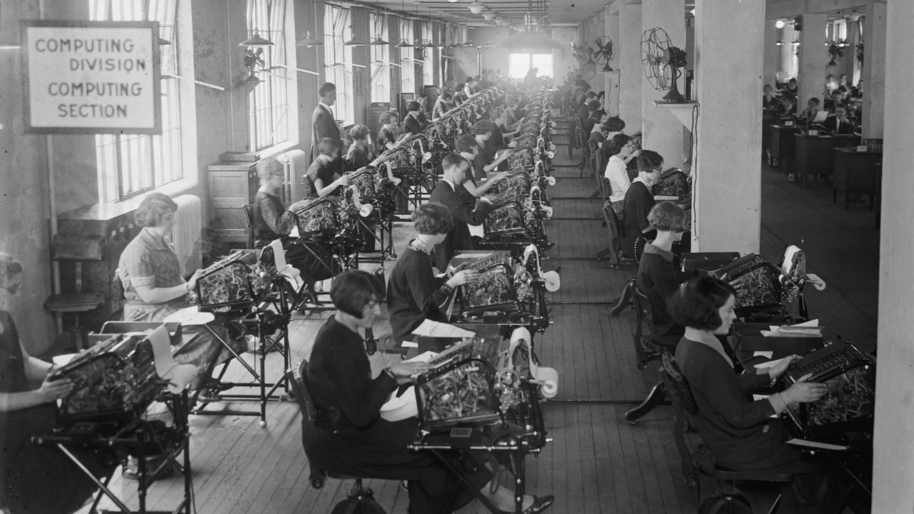
Bonus Bureau, Computing Division, 11/24/1924
https://www.loc.gov/pictures/item/2016838906/
Notes:
Calculating bonuses for veterans

Slide 22
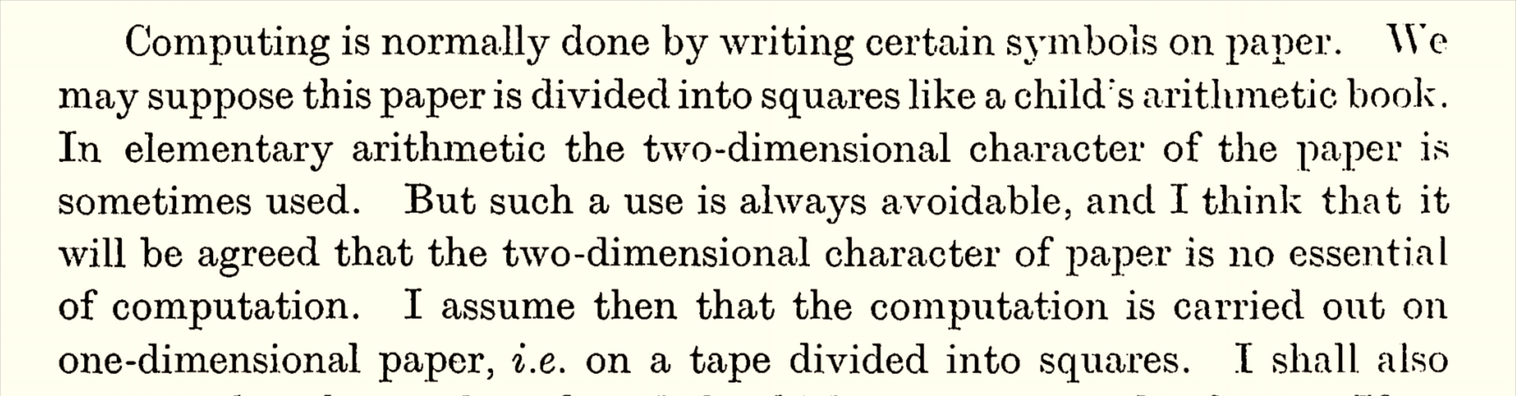

Slide 23
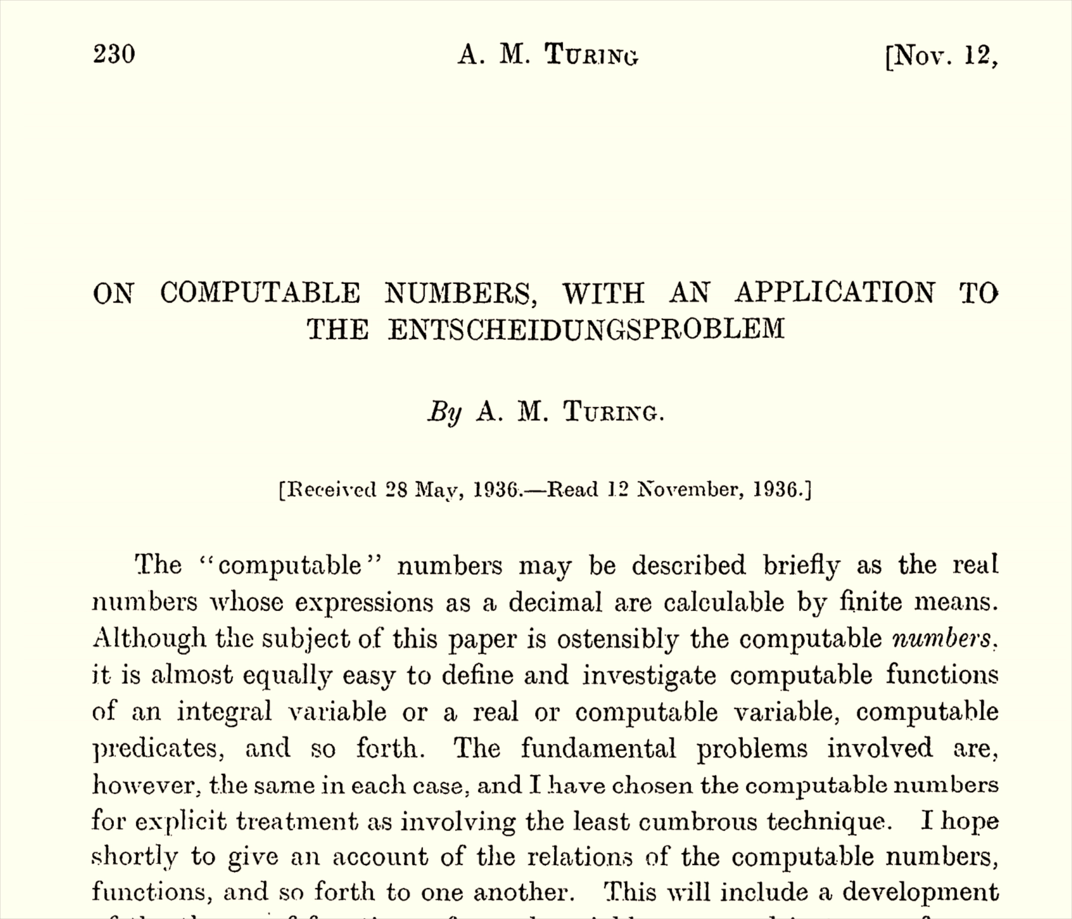

Slide 25
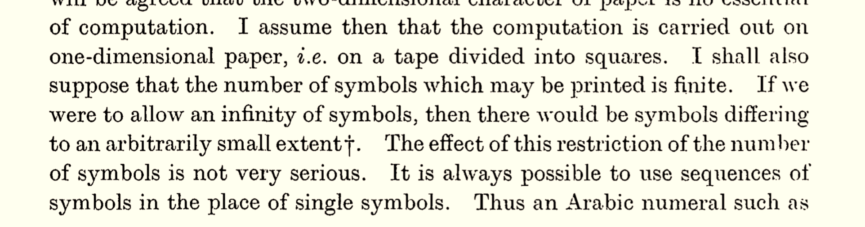


Slide 26


Slide 27

Why is the number of states finite?

